Slide 1
Digital Art: Humans and Nature SOAR 2014 Saint Anselm College CS255: Introduction to Computer Graphics Assoc. Prof. Mihaela Malita Selected class work
Stephen M. Iodice (CS ‘16) Matthew I. Burke (CS ‘14)
Michael D. Harper, Jr. (CS Bus ‘15) Ashley E. Ireland (CS ‘16)
George O. Lamptey (Bus ‘14) Zachary L. Lombard (Bus ‘15)
Neil J. O’Rourke (CS ‘16) Daniel G. Ruiz (Engineering ‘14)
Emmett C. Schaeffer (CS ‘15) Anthony P. Scouras (CS Bus ‘15)
James V. Scribi (Finance ‘15) Sean R. Smith (CS ‘16)
Joseph A. Tebano (CS ‘14) Matthew D. Yopp (CS ‘15)

Slide 2
Our technique
All our digital art has been generated by computer programs written in the programming language called Processing www.processing.org
invented by in 2010

Slide 3
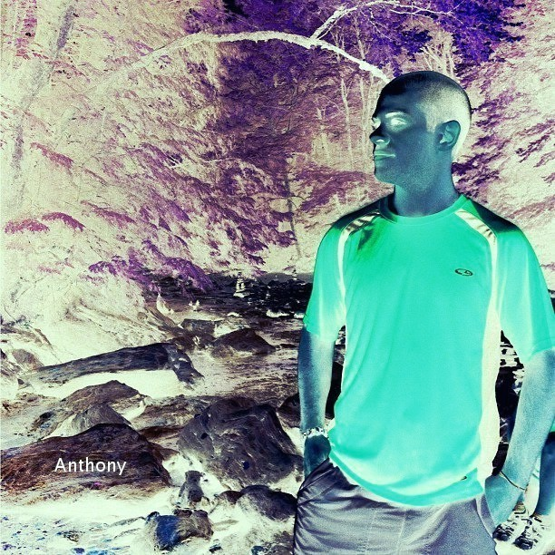
Art can be seen in many different ways and many different things can be called art. This is a collection of my opinion of
what art is
from simple objects to inverting colors.
Anthony Scouras
CS255
3/15/14
A little Change of color can give you a whole new prospective

Slide 4
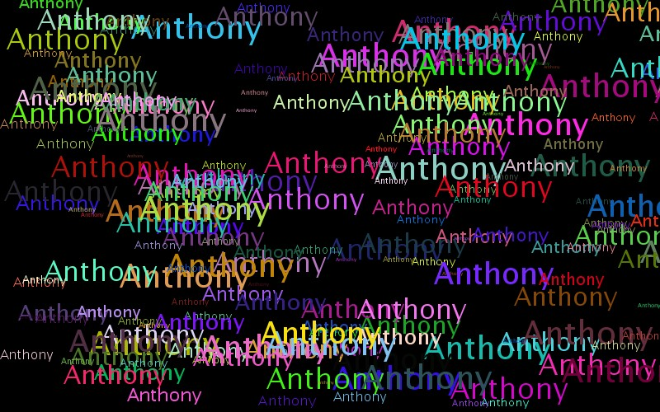

Slide 5
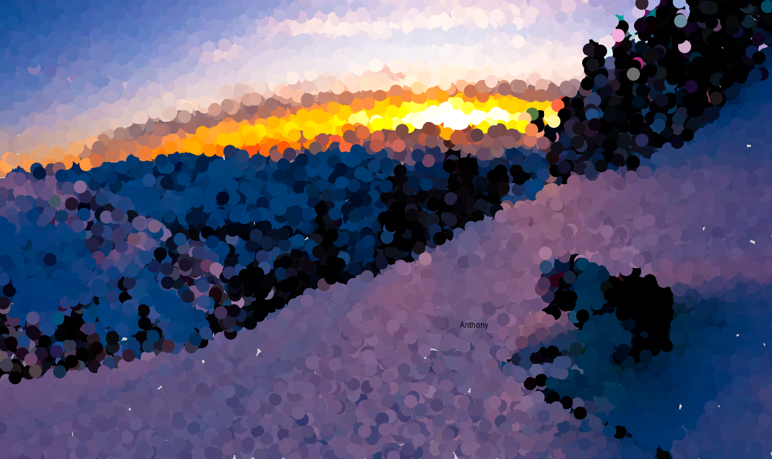
Dotted Mountain

Slide 6
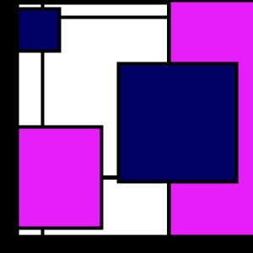
“PROPORTIONS” (MONDRIAN style)

Slide 7
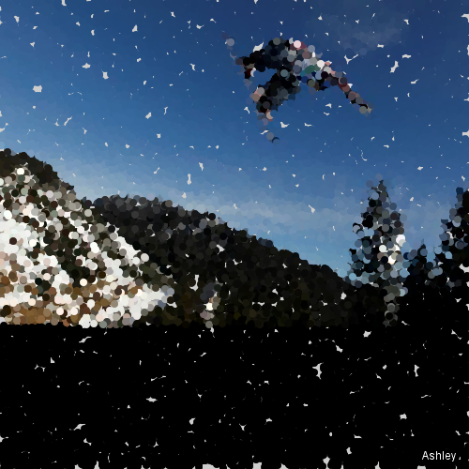
“OLYMPICS” (POINTILISM style)

Slide 8
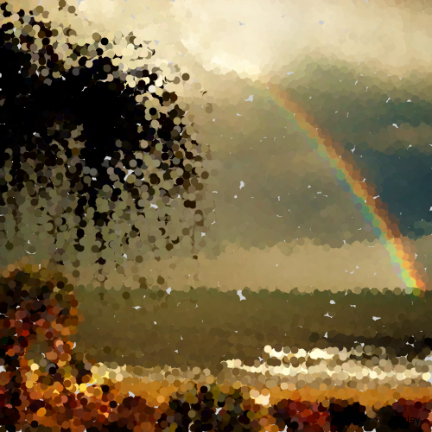
“RAINBOW” (POINTILISM style)

Slide 9
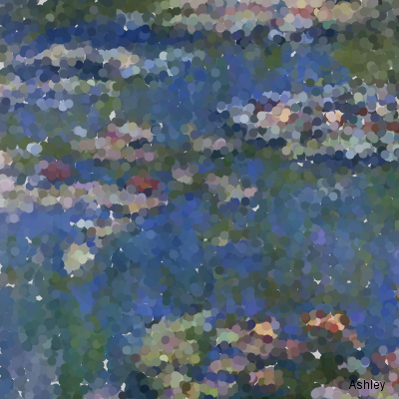
“POND” (POINTILISM style)

Slide 10
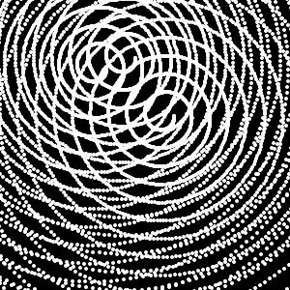
“PEARLS”

Slide 11
“BUBBLE GUM”

Slide 12
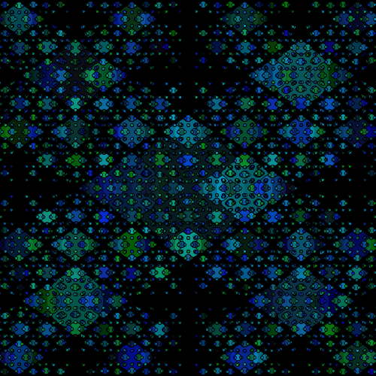
“RAIN”

Slide 13
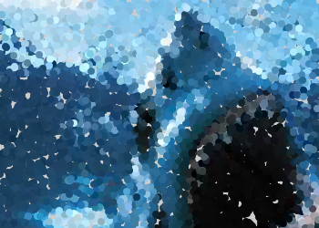
Hungry Shark
Using Pointillism to recreate a shark using spots.

Slide 14
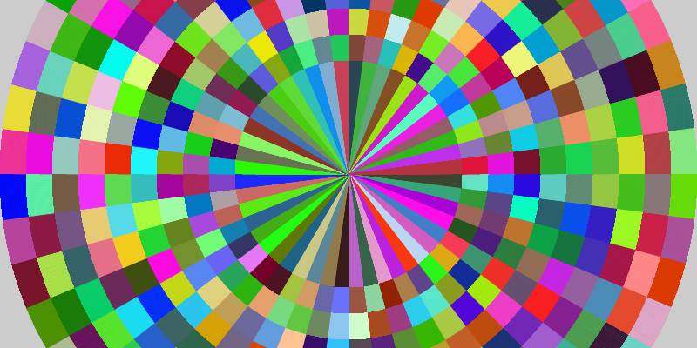
Rainbow Op Art
Used circles and squares to create an Op art effect

Slide 15
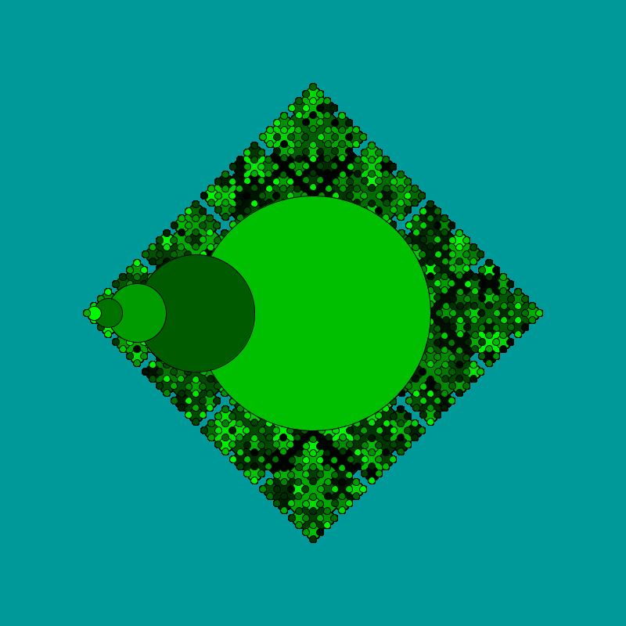
Olive

Slide 16
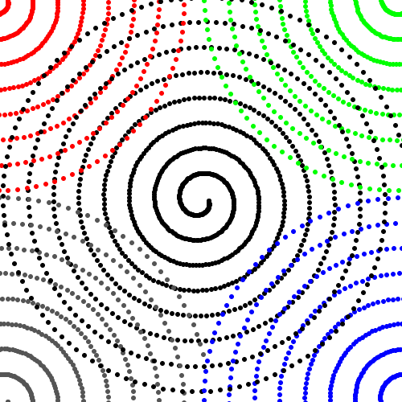
Hermit

Slide 17
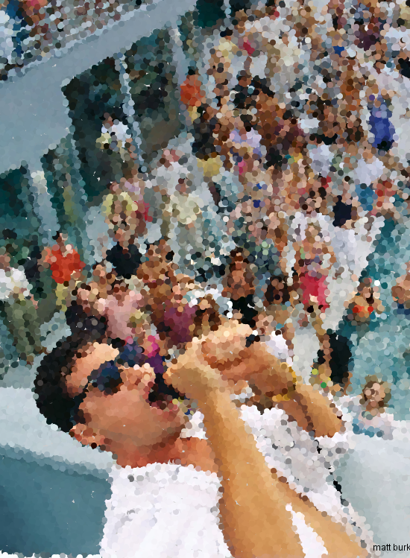
Wolfy

Slide 18
The Hunter being Hunted

Slide 19
Drip Art- Angel Fish

Slide 20
Live Life

Slide 21
The Sully
This is an example of pointillism. This picture is of Bryan Sullivan ‘16.

Slide 22
Circle Parade

Slide 23
Glow sticks

Slide 24
Golden Flower

Slide 25
Hungry Lions
Lion Original
Lion Alteration

Slide 26
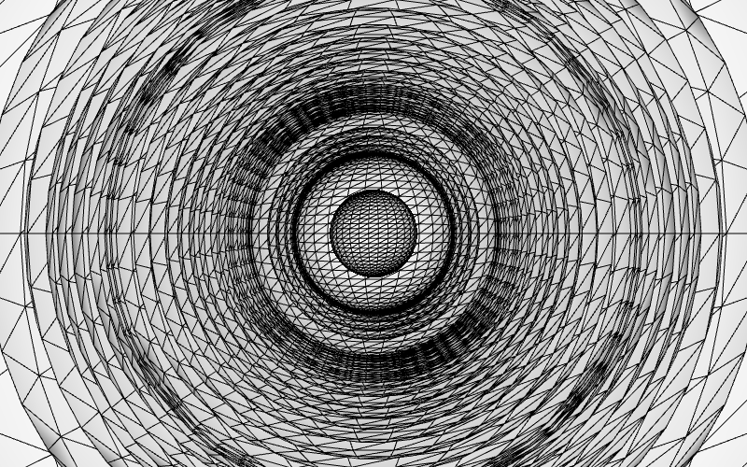
A Single Brush Stroke

Slide 27
The Fake Artist

Slide 28
Little Pieces to a big product

Slide 29
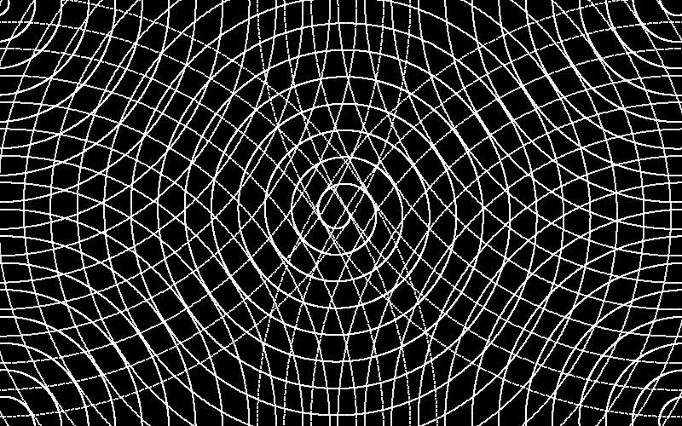
Simple Addition

Slide 30
Carpe Diem

Slide 31
Field of Dream

Slide 32
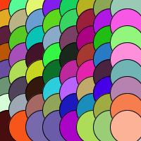
Scales

Slide 33
recursiveness

Slide 34
Dark Valentine

Slide 35
Bright Skies on a Dark Day

Slide 36
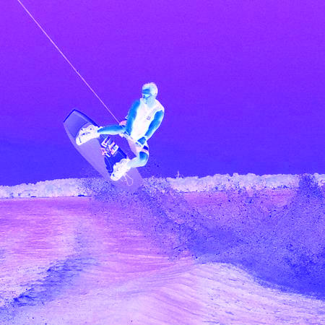
“Purple Wave”(Pop Art)

Slide 37
Mind Games
Optical Art

Slide 38
Here is the Processingcode

Slide 39
And here is what the code produces

Slide 40
Final Questions?
Show Class CS255 Spring 2014
Saint Anselm College
Thank you for listening!

